Slide 1
2023 TT Physiology Paper Display Items and General Discussion

Slide 2
Statistical Approach
Linear mixed effect models
Alliaria treatment included as categorical fixed effect in all models
Soil characteristics
Variable ~ Alliaria treatment * tree canopy status + (1 | plot)
Physiology traits
Variable ~ Alliaria treatment * tree canopy status + soil N availability +
phosphate availability + (1 | plot)

Slide 3
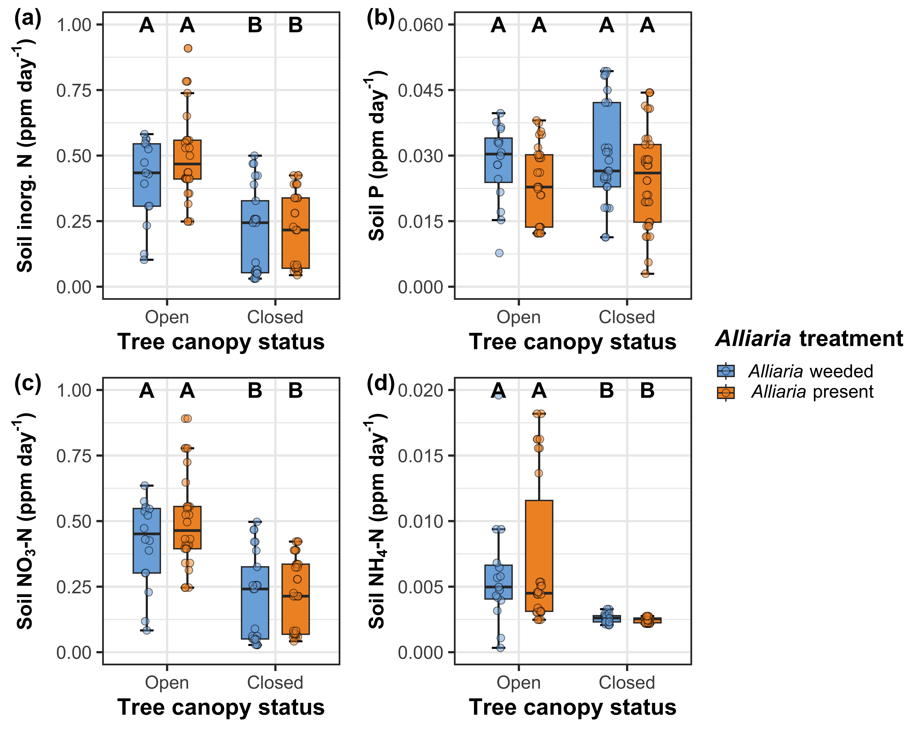
Alliaria presence does not affect soil nutrient availability

Slide 4
Alliaria presence does not affect soil nutrient availability
Soil nitrogen availability decreases with tree canopy closureAlliaria

Slide 5
Alliaria presence decreases net photosynthesis and stomatal conductance*

Slide 6
Alliaria presence decreases net photosynthesis and stomatal conductance*
Tree canopy closure decreases net photosynthesis

Slide 7
Alliaria presence does not alter indices of photosynthetic capacity*

Slide 8
Alliaria presence does not alter indices of photosynthetic capacity*
Tree canopy closure strongly decreases photosynthetic capacity

Slide 9
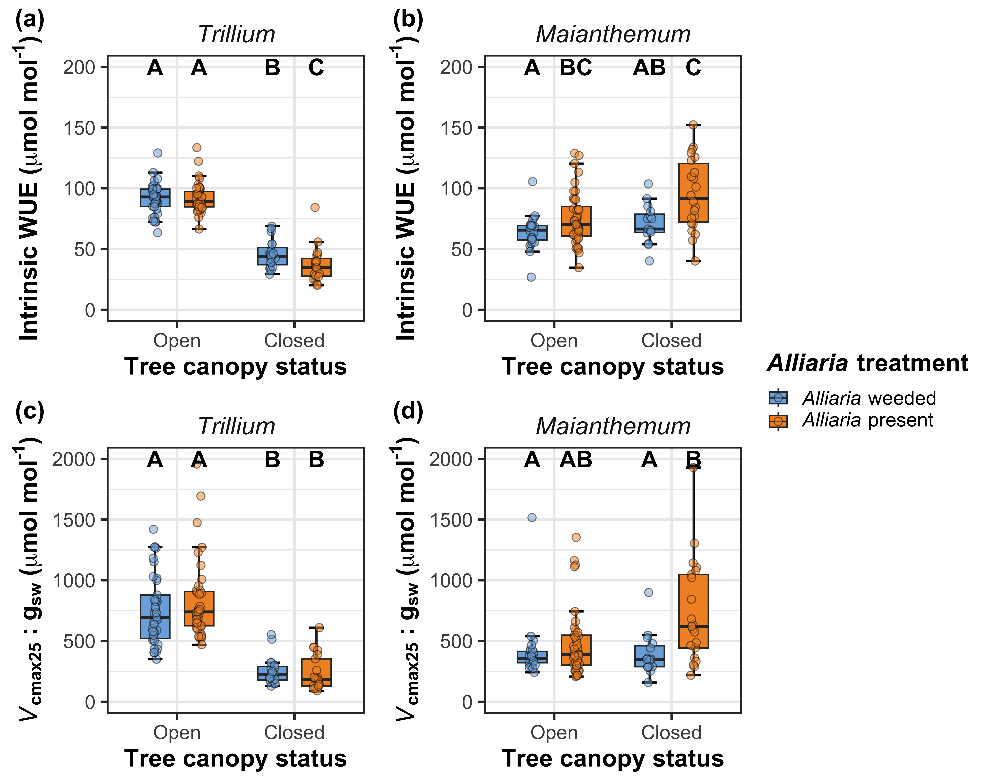
Alliaria presence has species-specific impacts on water-use efficiency and nitrogen-water use tradeoffs*

Slide 10
Alliaria presence has species-specific impacts on water-use efficiency and nitrogen-water use tradeoffs*
Tree canopy closure decreases water-use efficiency and nitrogen-water use tradeoffs, but only in Trillium

Slide 11
Key points for Discussion
Reduced net photosynthesis rates after canopy closure in both species, but did not alter photosynthetic capacity
Driven by changes in stomatal conductance (Trillium) or stomatal limitation (Maianthemum), not photosynthetic capacity
Alliaria-induced disruptions in belowground AM communities may have stronger consequences for costs of water uptake than costs of nutrient uptake
No change in photosynthetic capacity indicates that Alliaria invasion does not shift demand to build and maintain photosynthetic enzymes

Slide 12
Some open questions/logistics to figure out
Does it make sense to include some assessment of AM community composition here?
Alternative: sister paper submitted alongside this paper?
Authorship (see next slide)

Slide 13
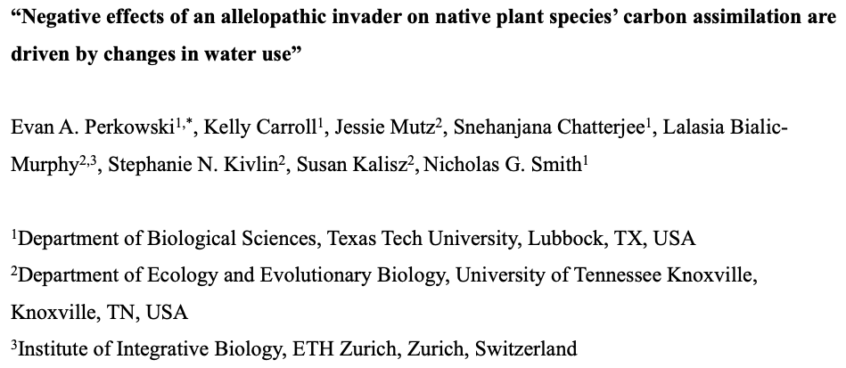
Proposed title and author list
Is there anyone missing here?
Notes:
First few authors ordered based on perceived contributions thus far, followed by alphabetical list of ECR and PI list

